Slide 1

Laws, Rules, Regulations, and Ethics of Online Therapy, including Out-of-State Practice, Online Apps/Programs, International Online Therapy
SexTherapy-Online, PLLC
Rhiannon Beauregard
Licensed Marriage and Family Therapist- Supervisor TX#202341
AASECT Certified Sex Therapist
Specialist-Problematic Sexual Behavior

Slide 2
Agenda for Today
10 am – 10:15 am: Introduction to Presenter and Attendees ✔️
10:15 am – 11:15 am: Introduction to Online Therapy ✔️
11:15 am – 11:30 pm: BREAK- Ask questions, use restroom, self-care ✔️
11:30 pm – 12:30 pm: Laws, Rules, Regulations, and Ethics of Online Therapy, including Out-of-State Practice, Online Apps/Programs, International Online Therapy
12:30 pm – 1 pm LUNCH
1 pm – 2:00 pm: Logistics of Online Therapy: The How To’s including HIPAA Compliance
2:00-2:45 pm: Risk Assessment and Crisis Management when Working Online
2:45 – 3:00 pm: BREAK- Ask questions, use restroom, self-care
3:00 pm – 4:00 pm: Advanced Concepts of Online Therapy: Online Therapy as a Model within Itself

Slide 3
Ethics of Telehealth and
Online Therapy
I approach the ethics of telehealth and online therapy in four ways:
  LEGAL
  ETHICAL
  RISK MANAGEMENT
  BEST PRACTICES, SCOPE OF PRACTICE, AND QUALITY OF CARE
I believe each of those factors should be weighed EQUALLY and no one take priority over the others.

Slide 4
Thoughts To Consider
Legal Issues
  What do the jurisdictional laws say?
Ethical Issues
  What do your ethical codes say?
Risk Management
  What does your insurance company say?
  How do you plan on handling emergency issues?
Best Practice, Scope of Practice, and Quality of Care
  Is this client appropriate for online sex therapy?
  Can I do my best work online?

Slide 5
Laws, Rules, and Regulations

Slide 6
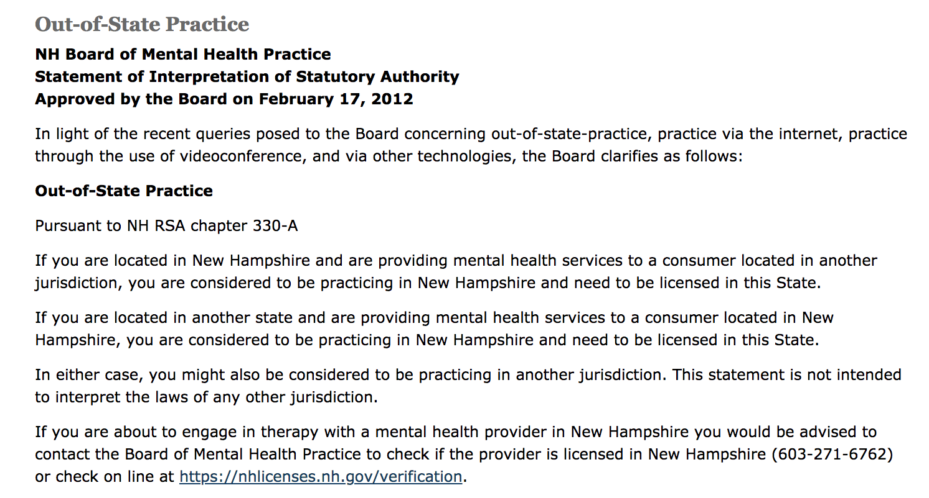
Laws, Rules, and Regulations
New Hampshire
Obtained from website 08/200/18

Slide 7
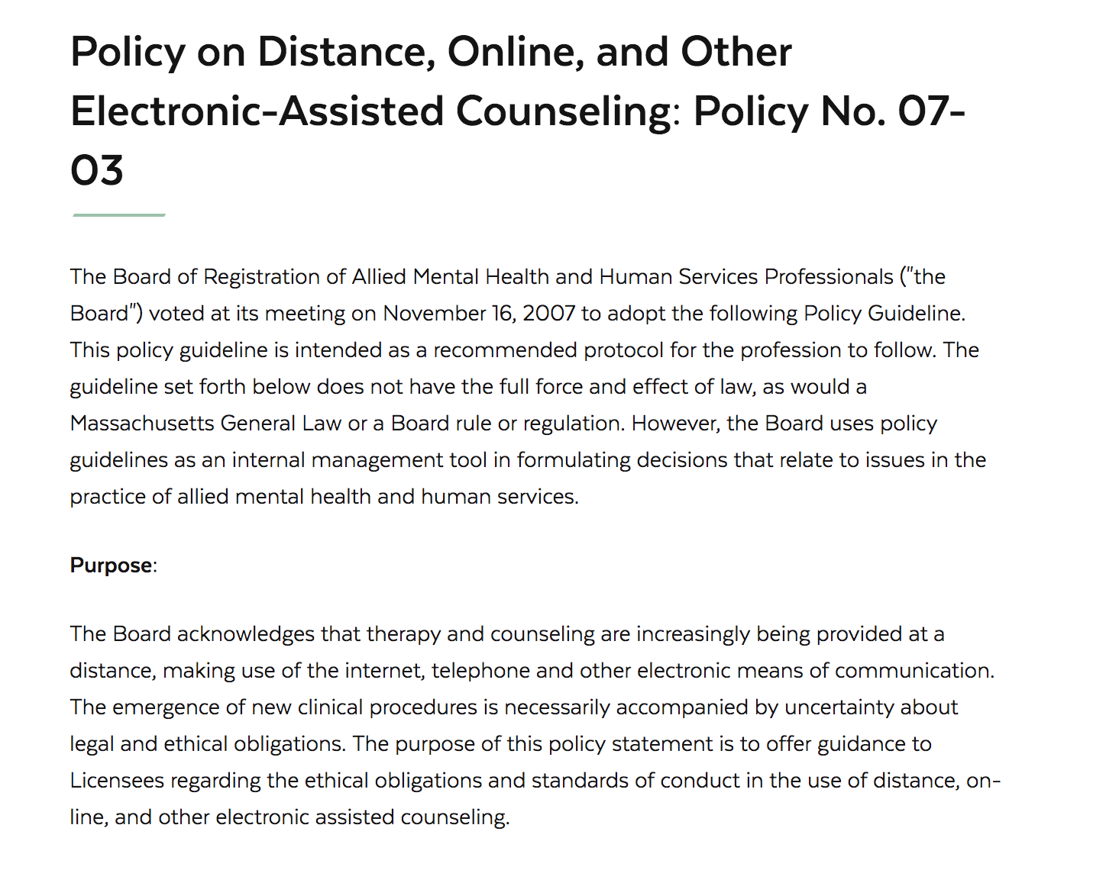
Laws, Rules, and Regulations
Massachusetts

Slide 8
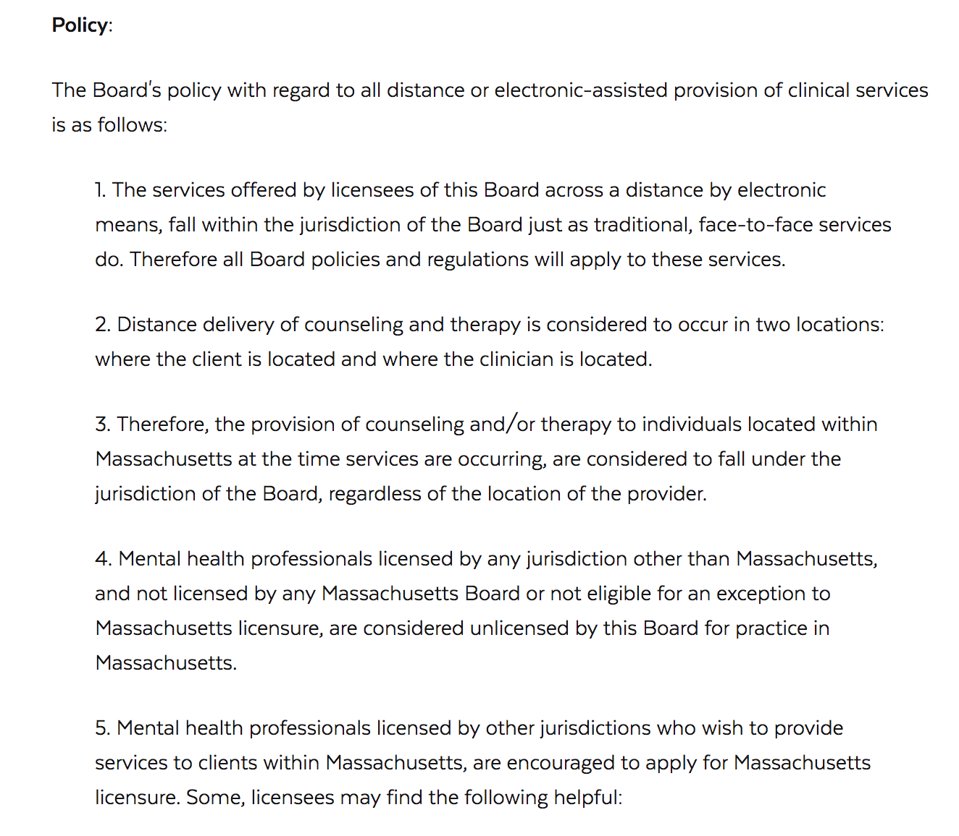
Laws, Rules, and Regulations
Massachusetts

Slide 9
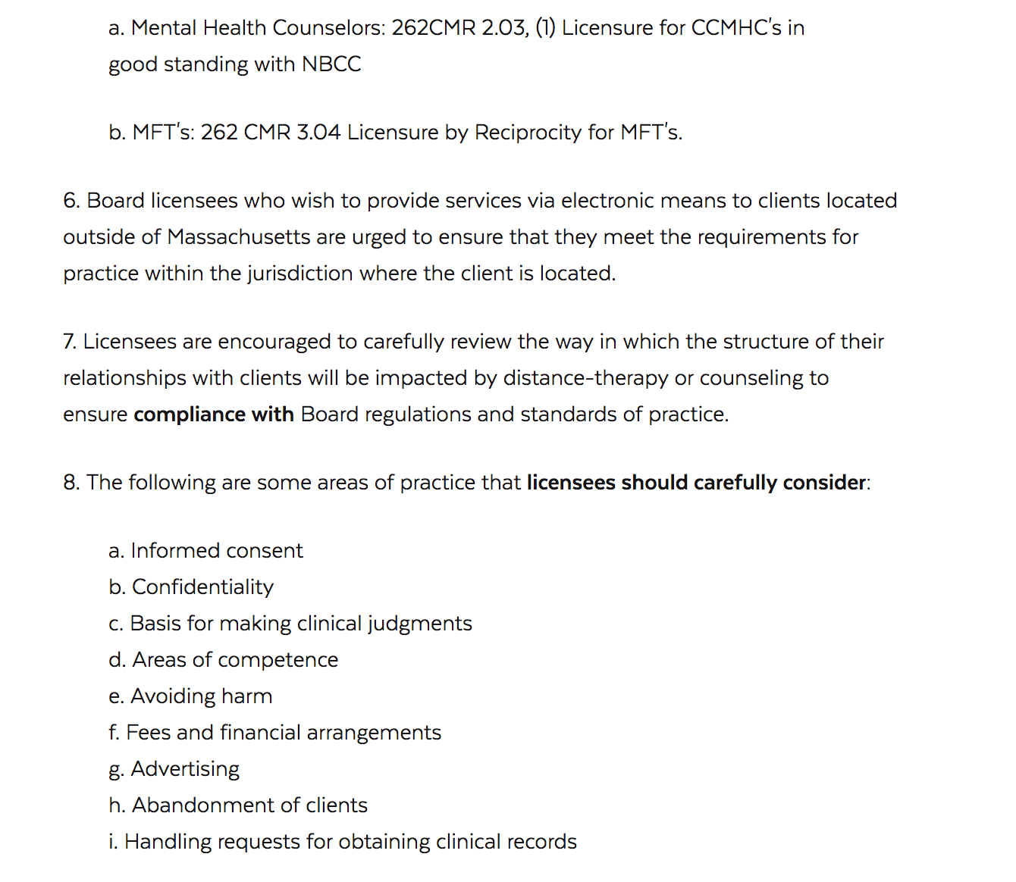
Laws, Rules, and Regulations
Massachusetts

Slide 10
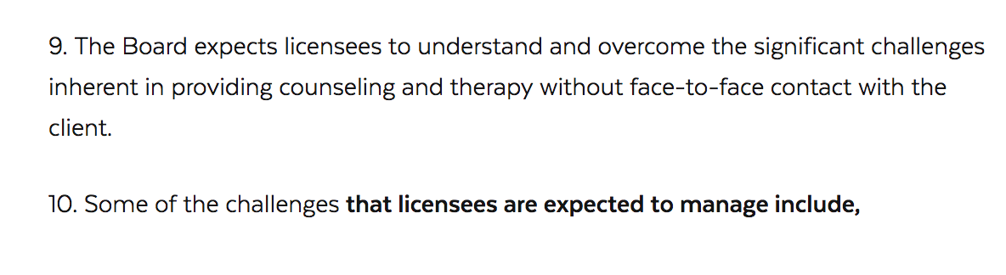
Laws, Rules, and Regulations
Massachusetts

Slide 11
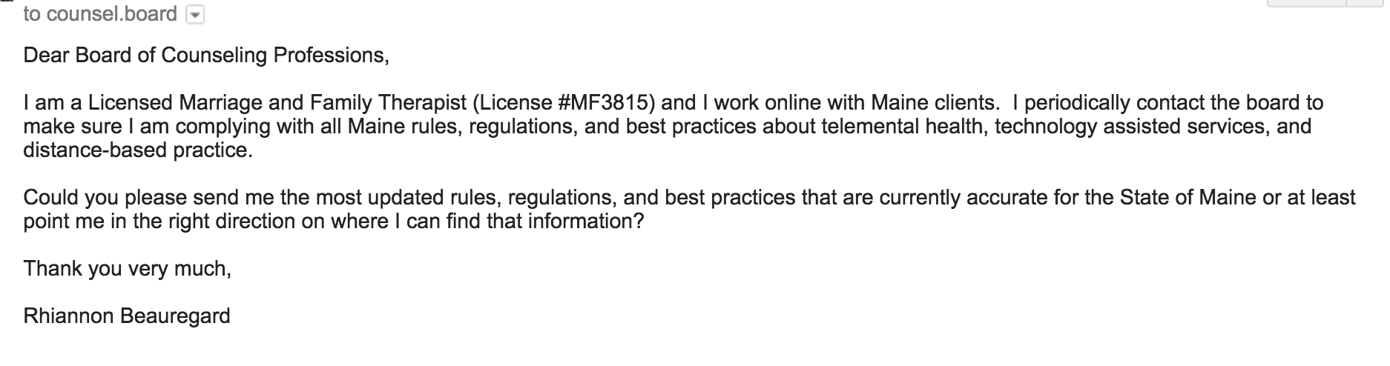
Laws, Rules, and Regulations
Maine

Slide 12
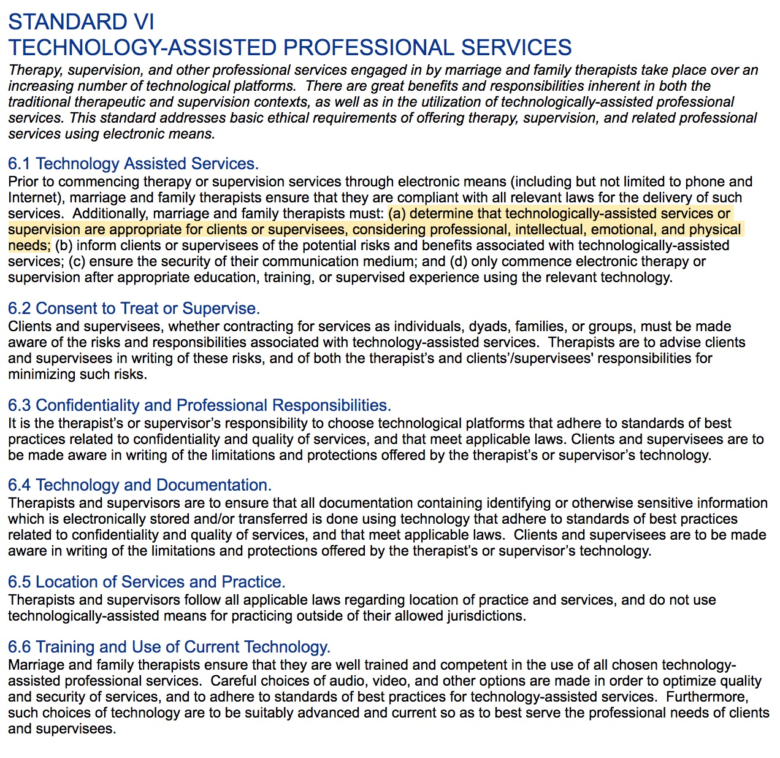
American Association of Marriage and Family Therapy (AAMFT) Code of Ethics
– Standard VI Technology Assisted Professional Services

Slide 13
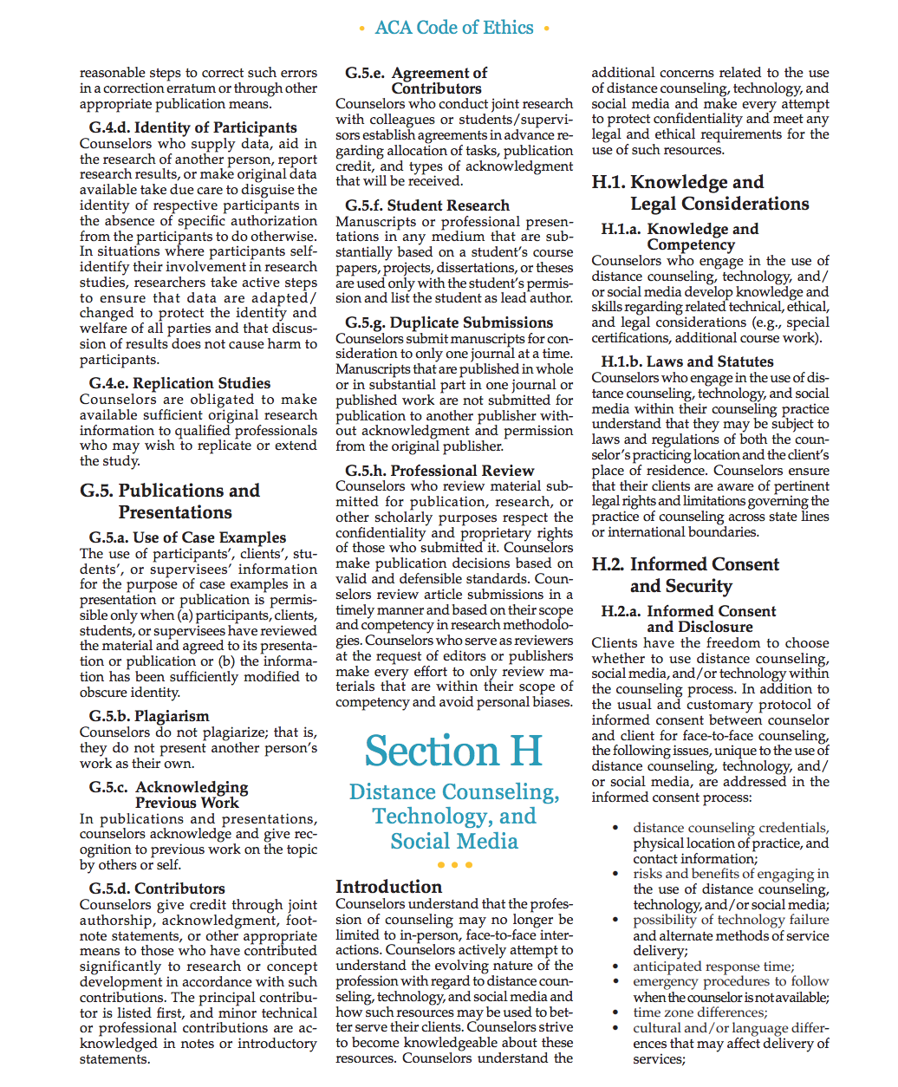
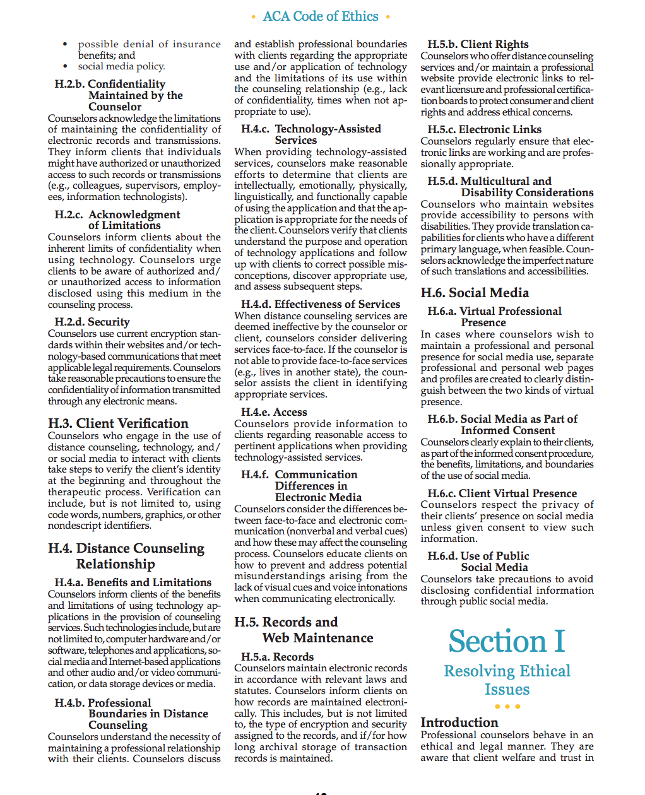
American Counseling Association Code of Ethics
– Section H Distance Counseling, Technology, and Social Media

Slide 14

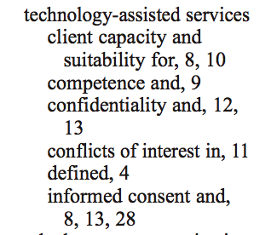
National Association of Social Work Code of Ethics

Slide 15
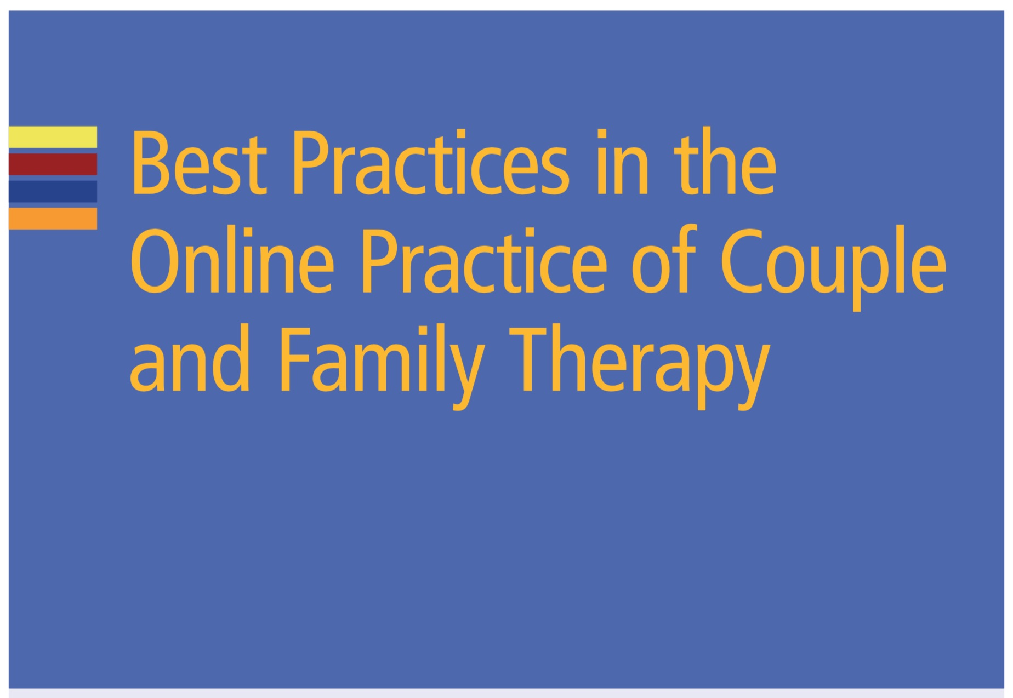
AAMFT Best Practices in the Online Practice of Couple and Family Therapy

Slide 16
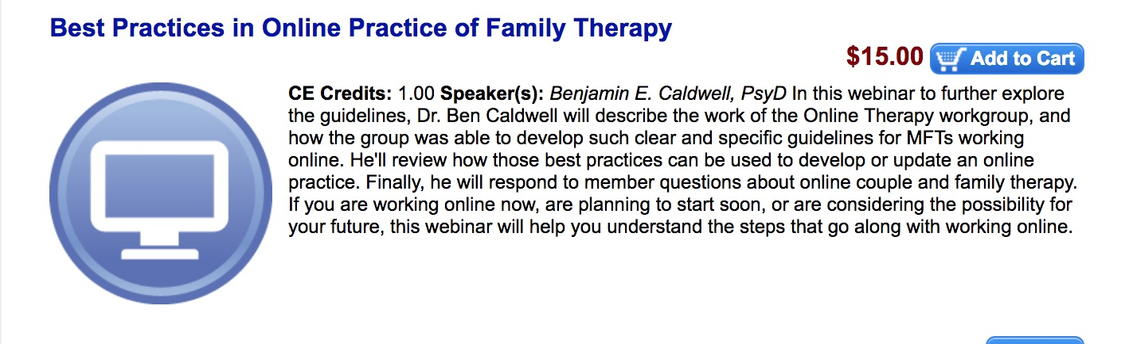
AAMFT Best Practices in the Online Practice of Family Therapy Online Webinar

Slide 17

Association of Marital and Family Therapy Regulatory Boards Teletherapy Guidelines

Slide 18
Online Apps/programs

Slide 19
Talkspace
Requirements: Highest clinical license in your state of residence, allowing independent clinical practice. Talkspace therapists only work with clients in the state(s) where they are licensed and allowed to practice independently.
Offers:
  Message Therapy
  Talk Therapy
  Couples Therapy

Slide 20

Talkspace

Slide 21
BetterHelp.com
Appears to be more text based, pays by words you read and write
What therapists are saying about it:
  “ It’s a great way to get comfortable! The pay is awful, but a great way to see how you feel about it.”
  I was on TS briefly, and I found that having to respond 2x a day (5 days a week) kept my mind too focused on my client's issues. I like to have a lot of space in between working with clients so I can clear my mind - so BH is a fit for me. There's a lot more video/phone sessions that I just do once a week, and if a client wants to write, I can respond to them every other day if I want (most don't write that often). Ideally, doing traditional weekly sessions (instead of frequent writing) is what I really prefer - so I'm moving in that direction!

Slide 22
Other Platforms
e-Home
ReGain
MyTherapist
Breakthrough
Good Therapy
MD Live
Ginger IO
SOME CONCERN ABOUT APPS and INFORMATION

Slide 23
International
Online therapy

Slide 24
International Online Therapy
Most nations regulate psychotherapy in a different manner than the US does, and many do not regulate it at all.
With a little effort, you can find out what the specific nation is that you are working in and aim towards compliance.
Lack of regulation for mental health professionals in a particular nation often means that practicing with people located there would be legal, but only by virtue of the fact that it’s not illegal.
(Source: Huggins, 2018)

Slide 25
International Online Therapy
Steps to Seeing Someone International:
  Verify with your licensing board that there are no restrictions to you seeing someone internationally (they will likely default to the fact that they do not regulate outside their state so you will need to verify in the other jurisdiction that it is legal to practice)
  Attempt to contact the jurisdiction regulating body in order to see what the laws are regarding providing mental health therapy to someone in their jurisdiction.
  Contact your malpractice insurance to ensure that they will cover you not only for 1) telehealth but 2) international practice.

Slide 26
International Online Therapy
Steps to Seeing Someone International, CONT:
  Ask the client for their help in this.
  DOCUMENT, DOCUMENT, DOCUMENT
  Ask the client if they could try to seek out at least three English speaking therapists on their own and document why they either could not find the therapist or they could not access them (due to distance, location, fee’s, etc.)

Slide 27
Case Presentation
Your 20-year-old client started therapy with you and you have been seeing them for a few months. She presented with managed depression, anxiety, a history of sexual trauma (she was had a relationship and was raped many times by her high school coach at 16 years old) and some suicidal ideation. She is headed to school in the Cayman Islands and are desperate to continue therapy during this transition. She previously had a traumatic experience with losing their therapist when She went to college in another state and wound up failing their semester and had a attempted suicide. Her permanent residence is in Texas.

Slide 28
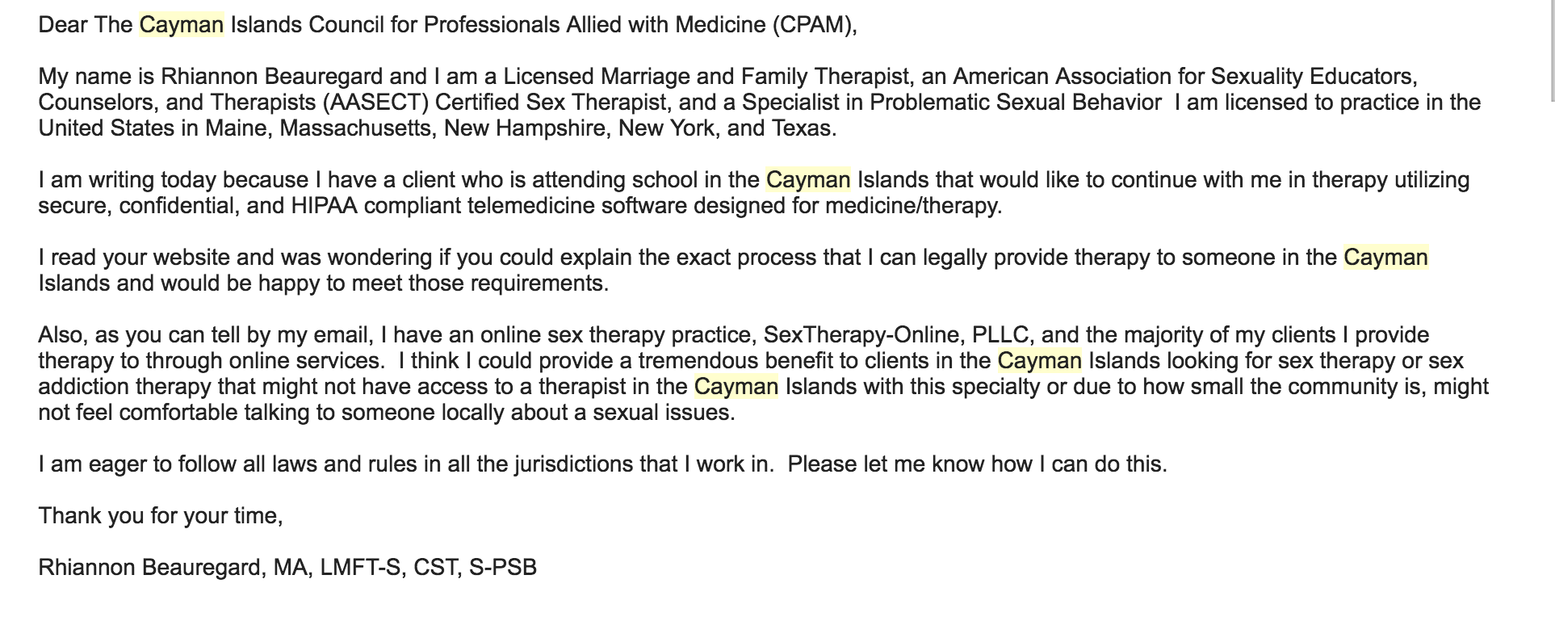
So What Do I do???

Slide 29
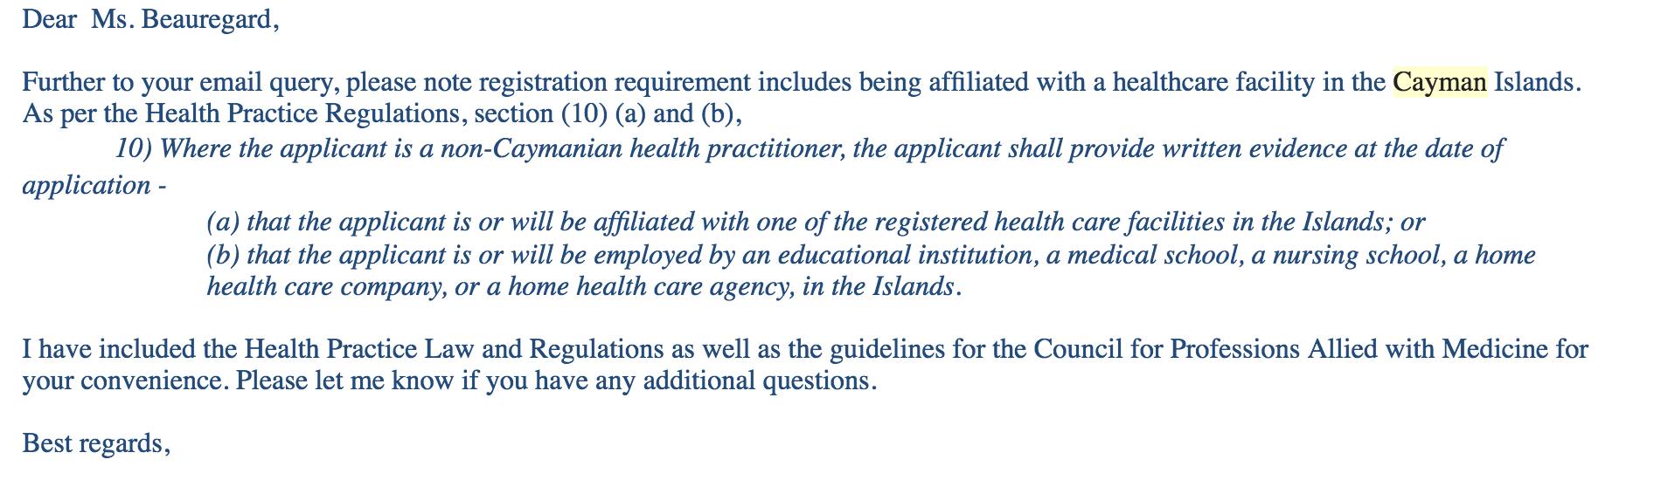
And WHAT did they say?

Slide 30

Any Questions?

Slide 31
Contact
www.SexTherapy-Online.com
Phone: 512-765-4741
Email: Rhiannon@SexTherapy-Online.com
Fax: 888.288.8495
Twitter: SexTherapyOnlne
Please feel free to contact for questions and materials!

Slide 32

Follow Me on Facebook and YouTube
Facebook: @RhiannonBeauregardCST
YouTube: rhiannon@sextherapy-online, #fetishfridays

